Slide 1

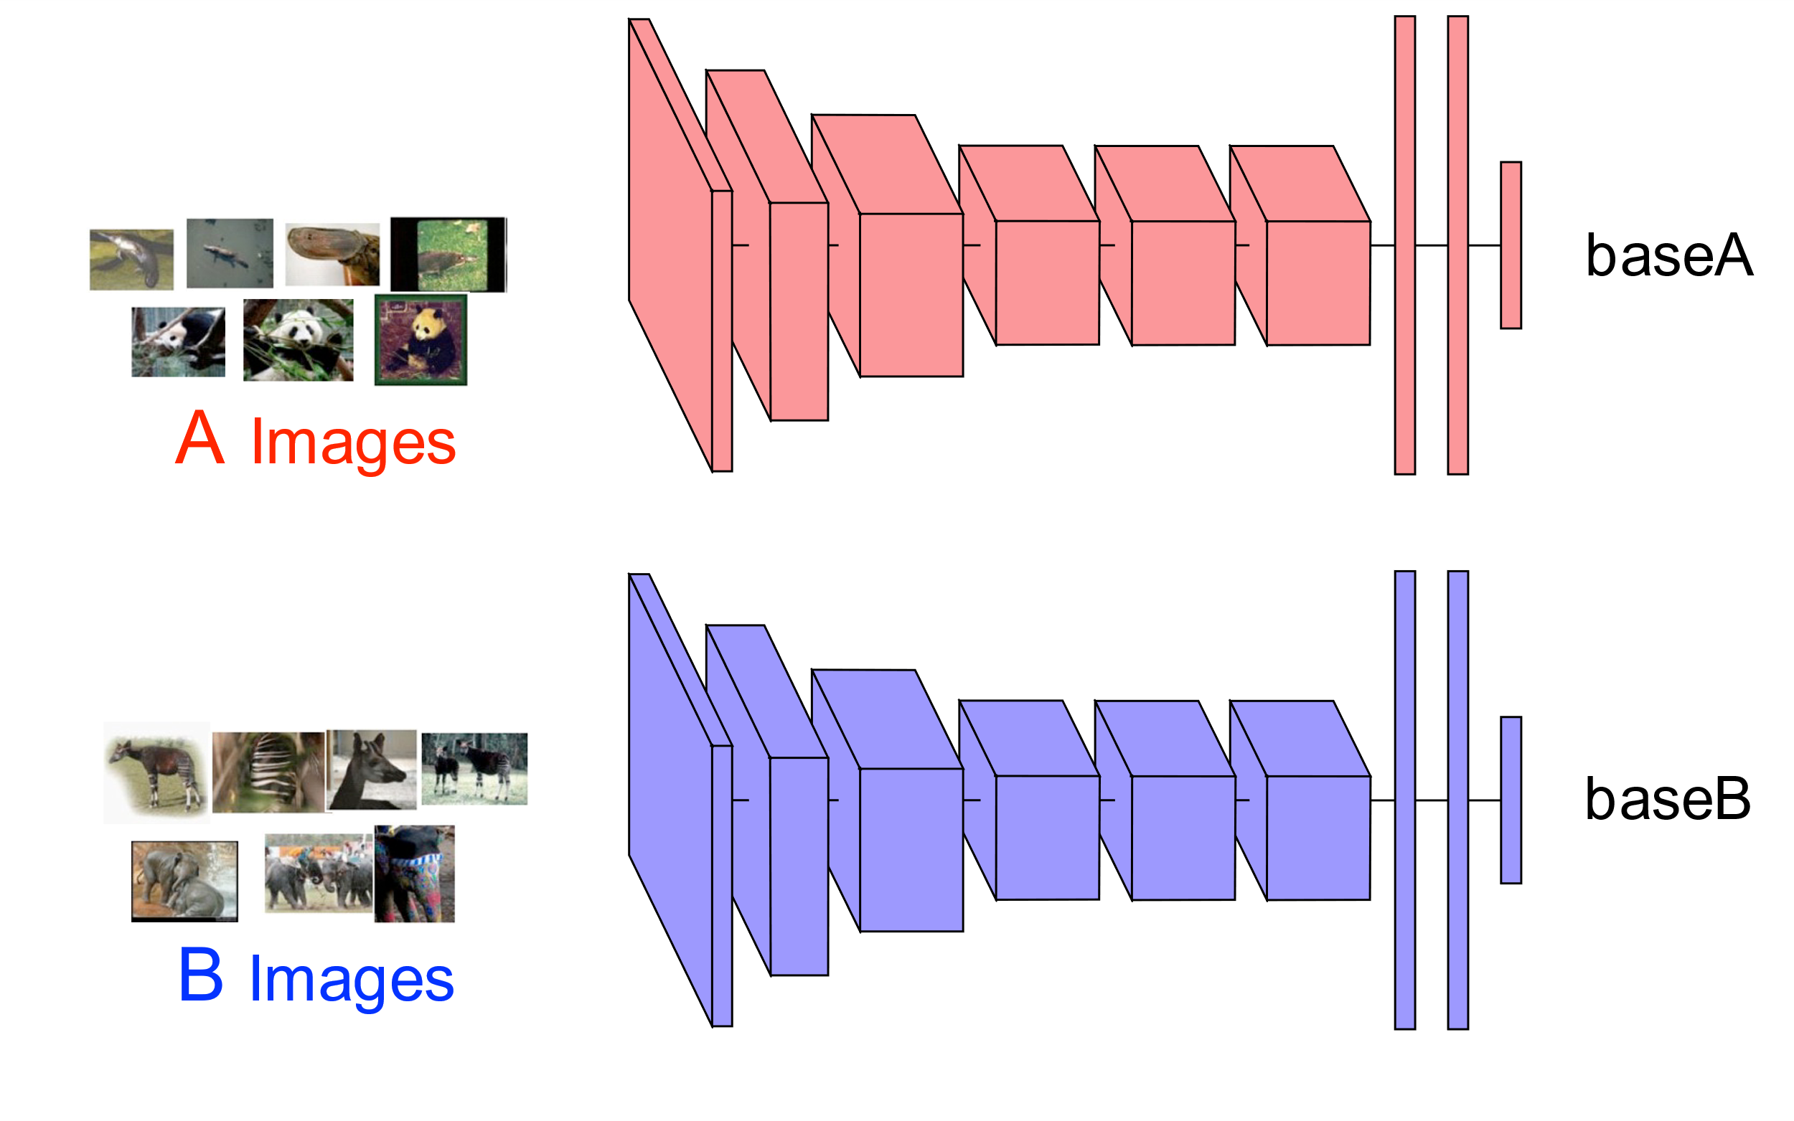
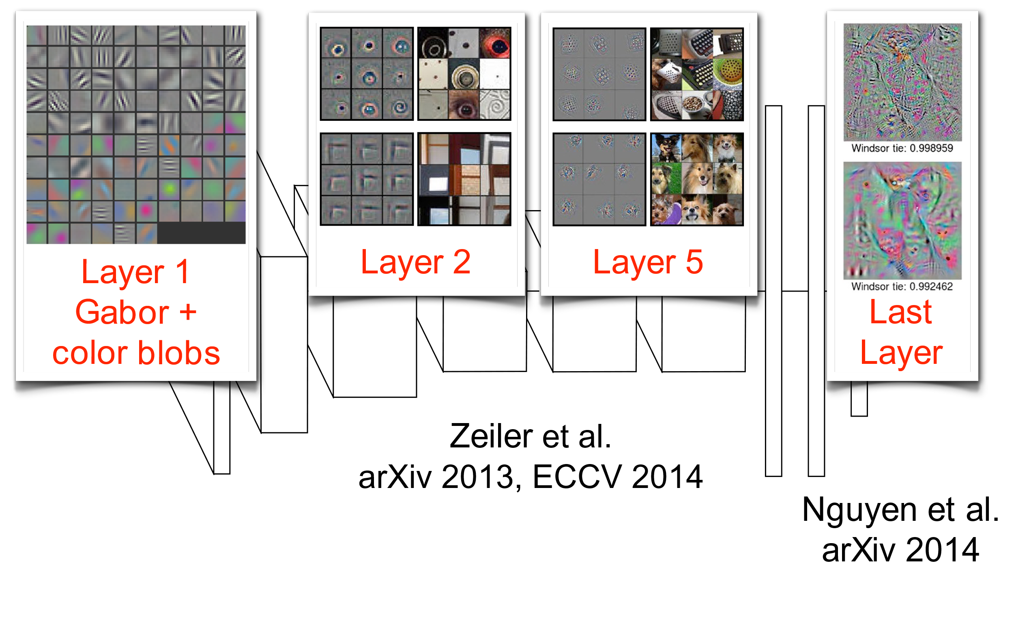
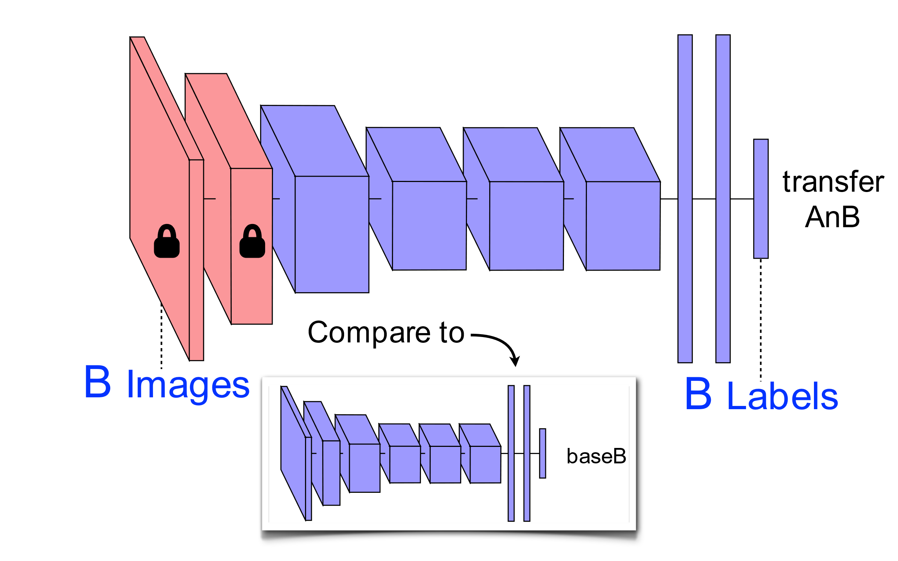
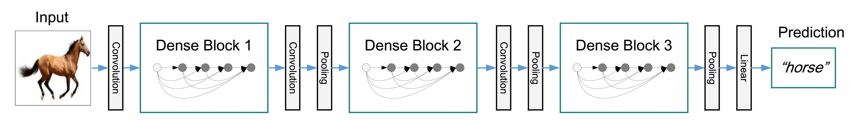

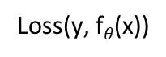
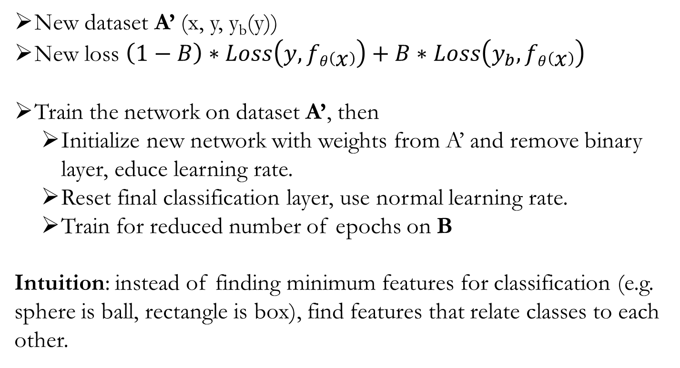
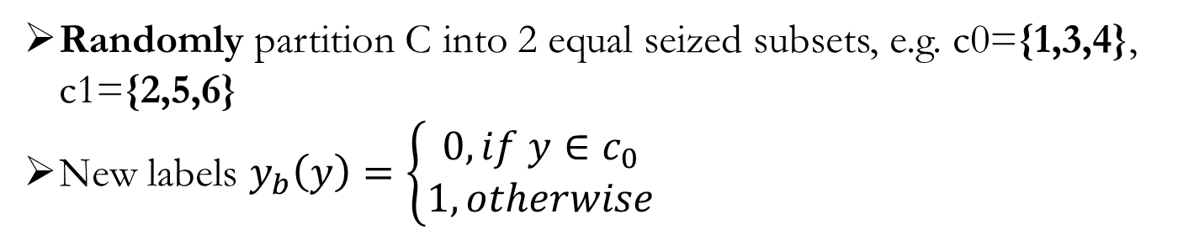
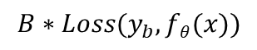
Maximizing Feature Extraction in Deep Neural Networks for Transfer Learning
Ayon Borthakur (ab2535) , Matt Einhorn (me263)
Introduction
Methods – con’t
Results - con’t
Results - con’t / Discussion
Randomly partition C into 2 equal seized subsets, e.g. c0={1,3,4}, c1={2,5,6}
New labels $y_{b}\left(y\right)=\left\{\begin{aligned}0, if y∈c_{0} \\ 1, otherwise\end{aligned}\right.$
Dataset A
Using a DenseNet (DenseNet-121 (k=32), 8M) on ImageNet-100 we also observe a performance improvement
Test error for classification and binary layers are smoothly converging
Dataset B
$$\left(1−B\right)∗Loss(y, fθ(x))$$
+
Binary layer in A improved performance on B
Weight of binary loss affected performance
More binary layers is worse than one binary layer
Training on multiple datasets:
We can train separate models for the separate data-sets
Performance may be reduced when there is not enough training examples for data-set B.
$$B∗Loss(y_{b}, fθ(x))$$
New dataset A’ (x, y, y_{b}(y))
New loss $\left(1−B\right)∗Loss\left(y, fθ\left(x\right)\right)+B∗Loss\left(y_{b}, fθ\left(x\right)\right)$
Train the network on dataset A’, then
Initialize new network with weights from A’ and remove binary layer, educe learning rate.
Reset final classification layer, use normal learning rate.
Train for reduced number of epochs on B
Intuition: instead of finding minimum features for classification (e.g. sphere is ball, rectangle is box), find features that relate classes to each other.
There is a dependency on class split
There’s always tradeoff between reduced performance on A with improved performance on B
Larger network (ResNet) has greater improvement, suggesting network needs sufficient capacity. Perhaps the DenseNet used is too small.
Instead, pre-train on dataset A:
Initialize first few layers with weights from A
Randomly initialize remaining layers
Reduce learning rate and “fine tune” on dataset B
This improves accuracy on dataset B [1, 4]
Binary classifier generally reduces the test error on dataset B at the cost of an increase in test error on dataset A.
Dataset B
Dataset A
Multiple binary layers reduces performance, suggesting there may not be nice minima for multiple layers
Transferring out of domain from CIFAR-100 to CIFAR-10 or SVHN showed no improvement.
Results
Methods
Dataset:
CIFAR-100, 32X32, 100 classes, 500 images/class for train, 100 images/class for test
50/50 split for A, B
Network:
DenseNet-BC (L=100, k=12), only 0.8M
Regime:
Train on A for 175 epochs with or without binary layer, fine-tune on B for 100 epochs (early stopping)
CIFAR100 (60) Dataset B
We would like to extract more features from A to increase fine-tuning performance on B.
Idea is to pose a harder problem to the network
Reducing CIFAR-100 to 60 images/class showed some improvement, but error was high and variable at different classes sizes
WideResNet (WRN-28-10 (drop 0.3), 36.48M) on CIFAR-100
Train 112 epochs on A, fine-tune 71 epochs on B
we observe an even greater performance increase
Given dataset A with data (x, y) where y∈ C={1, 2,…,N}, e.g. {1,2,3,4,5,6}.
Loss(y, f$θ$(x))
Conclusions / Future Work
Dataset B
Dataset A
Dataset B
References
Dataset B
Observed improvement on multiple architectures and datasets with a binary layer
Use larger and better optimized network
Increase number of replications to verify result is not random
[1] J. Yosinski, J. Clune, Y. Bengio, and H. Lipson, “How transferable are features in deep neural networks?,” in Advances in Neural Information Processing Systems 27, Z. Ghahramani, M. Welling, C. Cortes, N. D. Lawrence, and K. Q. Weinberger, Eds. Curran Associates, Inc., 2014, pp. 3320–3328.
[2] G. V. Horn and P. Perona, “The Devil is in the Tails: Fine-grained Classification in the Wild,” SciRate, Sep. 2017.
[3] D. Arpit et al., “A Closer Look at Memorization in Deep Networks,” ArXiv170605394 Cs Stat, Jun. 2017.
[4] M. C. Kruithof, H. Bouma, N. M. Fischer, and K. Schutte, “Object recognition using deep convolutional neural networks with complete transfer and partial frozen layers,” presented at the Optics and Photonics for Counterterrorism, Crime Fighting, and Defence XII, 2016, vol. 9995, p. 99950K.
[5] B. Amos, densenet.pytorch: A PyTorch implementation of DenseNet. 2017.
[6] W. Yang, pytorch-classification: Classification with PyTorch. 2017.
[7] vision: Datasets, Transforms and Models specific to Computer Vision. pytorch, 2017.

